Slide 1

Hostel Management System
Name: Ajaykarthi Nagarajan
Batch: EB_JAVA 5768
Enrollment No: EBEON0721410266

Slide 2
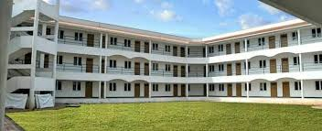
Introduction
The “HOSTEL MANAGEMENT SYSTEM” is an application developed for managing various activities in the hostel. This project deals with the problems of managing a hostel and avoids the
problems which occur when carried manually.
This application is useful to avoid the manual
data entry and is easy to access the data about the
hostels. Thereby the management of hostel
becomes easier to maintain and access. The
application is provided with easily understandable
and userfriendly GUI.
The main objectives of the project are to reduce the human effort and processing time in maintaining the student and staff information, acessing the data more easily.

Slide 3

Content
Home
Gallery
Alumni Review
Fee Structure
Registration Process
Notice Board
Login
Feedback

Slide 4
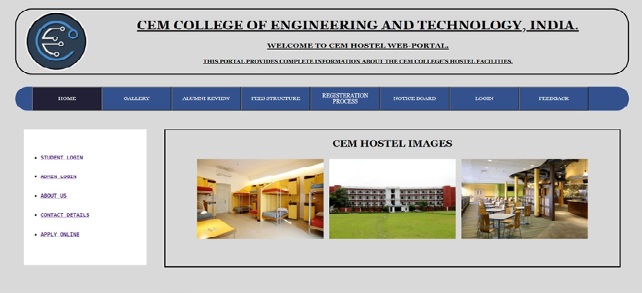
Home Page

Slide 5
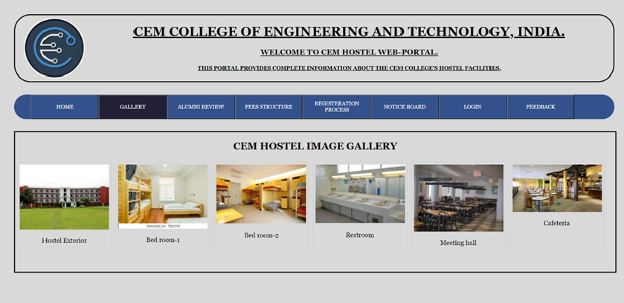
Gallery

Slide 6
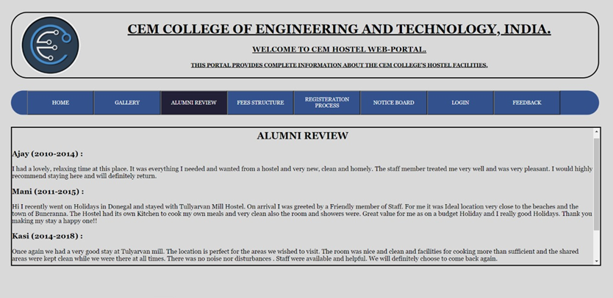
Alumni Review

Slide 7
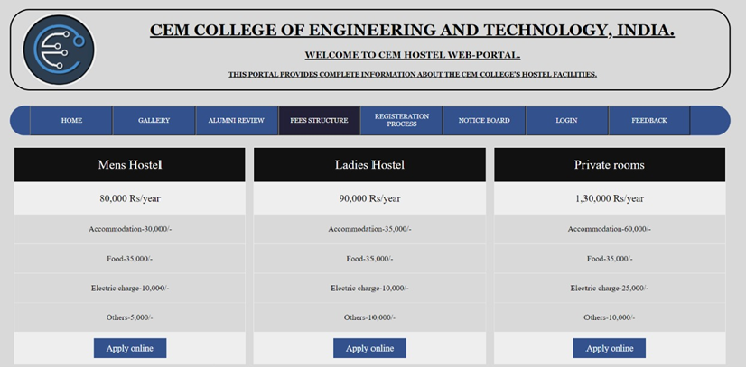
Fee Structure

Slide 8

Registration Process
Registers are temporary storage areas for instructions or data. Registers work under the direction of the control unit to accept, hold, and transfer instructions or data and perform registeration process.
It helps to collect the required data from the new user and send it to the college offecials(Admin), So that they can contact the students for further details.

Slide 9
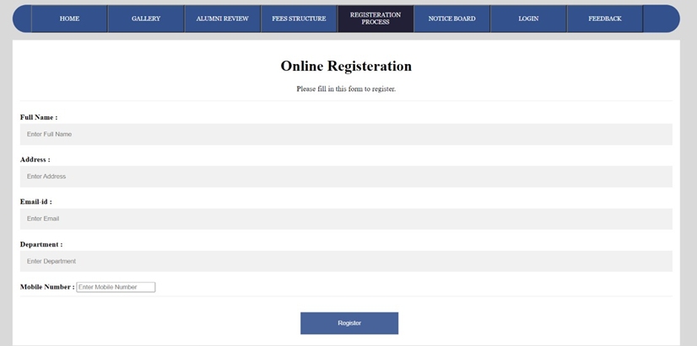
Registration Process

Slide 10

Notice Board
Notice boards are used in many
different types of organizations for
communication purposes.
Using these types of boards is an
effective way of displaying information
and communicating with staff and
visitors.

Slide 11
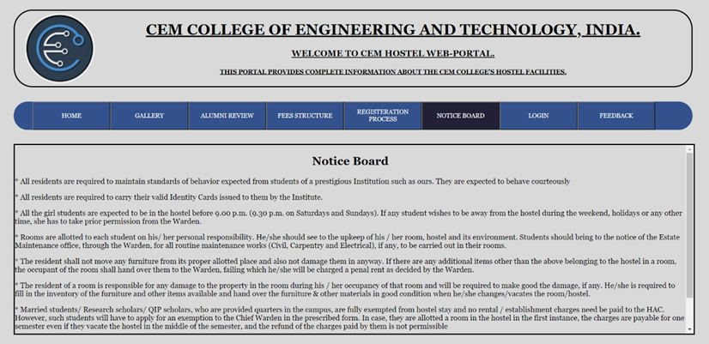
Notice Board

Slide 12

Login
A login page is a web page to a website that requires User identification and authentication, regularly performed by entering a username and password combination.
When users come to a web page, and already have an account it should be immediately clear where they go to login. Rather than providing a ‘Login’ link it’s better to show the input fields, so that users can login directly from a page.

Slide 13
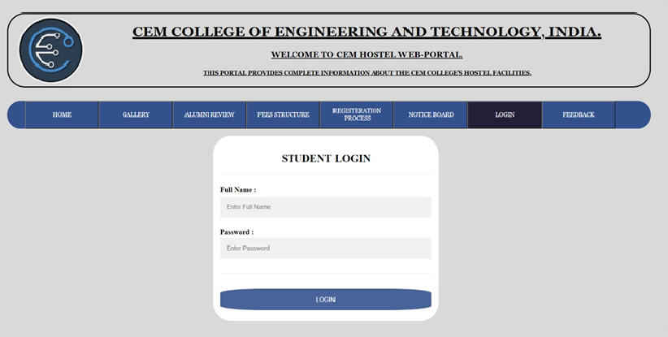
Login

Slide 14

Feedback
Hostel is a place where food and lodging
are provided for students . Life in a hostel is
different from the life in a home.
So Feedback is one of the major tool to
collect information or drawbacks of the hostal
so it can be corrected in upcoming days.
Which makes the hostel a better place for
the students.

Slide 15
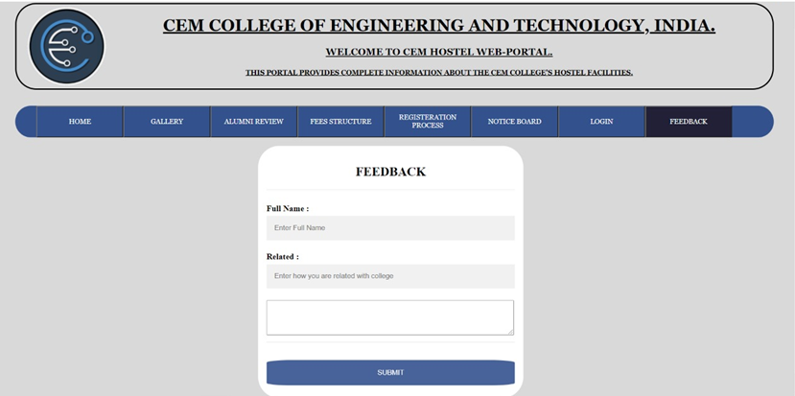
Feedback

Slide 16

Technology Used
HTML
CSS
Java Script

Slide 17

Conclusion
Hostel Management is a user-friendly and Customization software for college Hostel.
Hostel management system has been developed to manage and automate the over-all processing of any large college hostel.
This project is a very flexible software and it can be upgraded according to the individual hostel needs.

Slide 18


